Slide 1
MX2020 Big Data
Data Leke Reference Architecture
Alerts and Notifications - Tactical solution
March 19, 2020

Slide 2
Change control
Versión | Fecha | Descripción del Cambio | Autor/Departamento
0.7 | 10/05/2020 | Creation of the document | [Big Data Architecture] Susana Edith Barrientos Galicia
0.2 | 13/05/2020 | The use case model diagram is integrated | [Big Data Architecture] Susana Edith Barrientos Galicia
0.3 | 15/05/2020 | The general diagram of components is integrated | [Big Data Architecture] Susana Edith Barrientos Galicia
0.4 | 18/05/2020 | The internal structure diagram of the commonHadoop component is integrated | [Big Data Architecture] Susana Edith Barrientos Galicia
0.5 | 20/05/2020 | The internal structure diagram of the commoLog component is integrated | [Big Data Architecture] Susana Edith Barrientos Galicia
0.6 | 22/05/2020 | The deploy diagram, volumetry is integrated and some points that impacted the architecture are detailed | [Big Data Architecture] Susana Edith Barrientos Galicia

Slide 3
Change control
Versión | Fecha | Descripción del Cambio | Autor/Departamento
0.7 | 26/05/2020 | Deployment diagram integrated | [Big Data Architecture] Susana Edith Barrientos Galicia
1.0 | 19/06/2020 | The internal structure diagram of the cmpCitiDataAccess component is integrated | [Big Data Architecture] Susana Edith Barrientos Galicia

Slide 4
Table of Contents
Features and terminology
Needs and Solution Proposal
Graphic Representation of the Solution
Infrastructure and Connectivity
General services
Risks and Dependencies
Standards, Patterns and Decisions of Architecture
References and Annexes

Slide 5
Features and terminology

Slide 6



Features and terminology (I)
Data Lake - Alerts and Notifications
Data Sources
Acquisition & Ingest layer
Processing Layer
Abinitio
Raw
Curated
Augmented
Layers of Architecture of a Data Lake
Batch Layer
N... node
Functional division for the data life cycle
Hue
Hue
Sentry, Kerberos
UI Framework
SDK
Workflow
Workflow
Hive
Oozie
Scheduler
Metadata
Languages, Compilers
Fast read / write access
Flume, Sqoop
Pig / Hive
HBase
Data Integration
Components of the batch layer
HDFS
Hadoop Distributed File Systems
Job
Spark
Processing
YARN
Resources Manager
Zookeeper
Coordination
cloudera
Data Lake

Slide 7
Needs and Solution Proposal (I)
Descripción de la solución técnica
Objective
Define core components, pieces of code for the Data Lake Notification and Alerts project architecture
Scope
Represent graphics of the components, internal structure and integrations, incorporating the use of good design and development practices in the different phases of the software engineering process.
Description
Due to the reengineering of the Architecture of the Alerts and Notifications area, the following functionalities for the Data Lake are identified:
Validate the structure of the Event
Move Row Zone data to Cured
Process the data according to certain Alerts and Notifications business rules, make a view available for the visualization tool
Completeness and data quality

Slide 8

Needs and Solution Proposal (II)
New component
Component to modify
Data Lake - Alerts and Notifications – Global Architecture (Tactical solution)
Component not contemplated
General flow
Data Sources
Serving Layer
Integration with Hadoop components
Acquisition & Ingest layer
Processing Layer
A
B
Abinitio
Raw
Curated
Augmented
1.
Visualization Tool
Abinitio ETL sends the Json file with the events of the day to the Zona Row
El Job de Data Lake valida la existencia del archivo y la estructura del Json
The Data Lake Job validates the existence of the file and the structure of the Json
The Data Lake job moves Row data to Cured by creating the table in Hive, processes the information based on the Alerts and Notifications business rules
The Data Lake Job creates a view in Hive with the data it processes to make it available to the tool in visualization
4.
Batch Layer
N... node
Hue
Hue
Sentry, Kerberos
UI Framework
SDK
Workflow
Workflow
Hive
Oozie
Scheduler
Metadata
Languages, Compilers
Fast read / write access
Flume, Sqoop
Pig / Hive
HBase
Data Integration
A
2.
HDFS
Hadoop Distributed File Systems
B
Job
Spark
Processing
3.
YARN
Resources Manager
Zookeeper
Coordination
cloudera

Slide 9
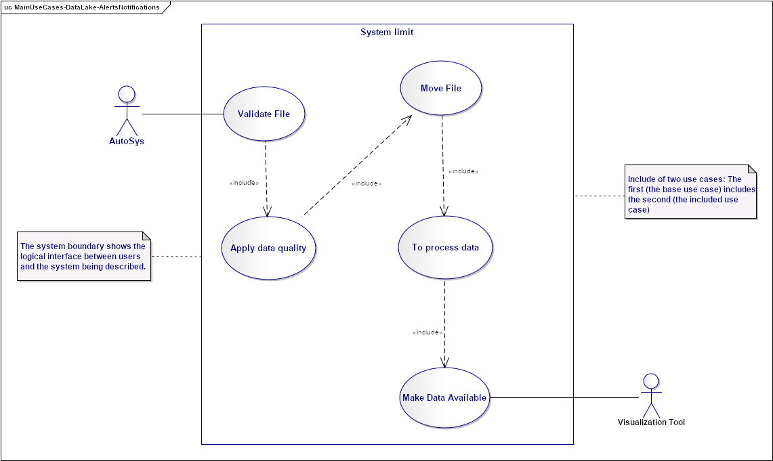
Needs and Solution Proposal (III)
Data Lake - Alerts and Notifications – Use Case View
Validate file: the ingestion engine deposits the file in the raw zone to carry out the validation process of the existence and structure of the files according to a defined contract
Apply data quality: full data rules need to be applied
Move files: it is necessary to move the data to the cured HDFS zone in the domain-specific path corresponding to the Alerts and Notifications data
It is required to load the data in the Cured Zone in Hive and process the data according to the commercial rules of the Alerts and Notifications area
Make data available: loading data into Hive views is required to supply the data to the visualization tool
3.
1.
2.
4.
As part of the software engineering process, it is recommended to prepare the use cases to identify the following:
Preconditions
Post-Conditions
Normal Flow
Alternative Flow
And if necessary to exist:
Variants
Business rules
Special requirements
Notes
In the use cases, the test cases are detected, that is why it is important to prepare them because they are the contracts that define the project, determine the agreements with the business area involved and are a reflection of the flow of functionalities.
A template is attached to develop a use case
5.

Slide 10
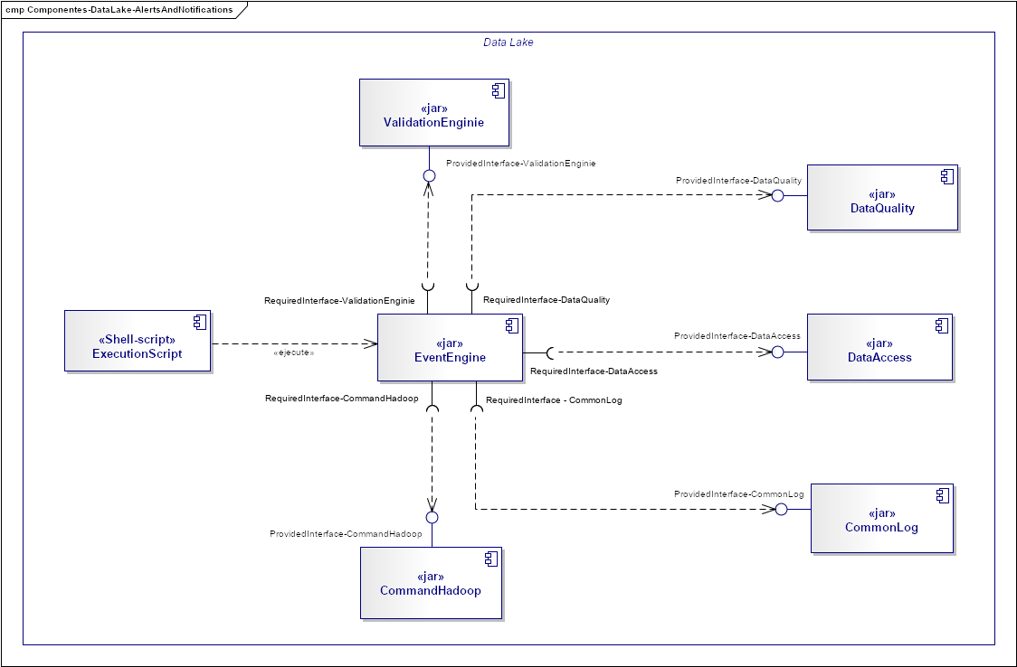
Needs and Solution Proposal (III)
New component
Component to modify
Data Lake - Alerts and Notifications - Component View
Component not contemplated first phase
EventEngine: It is the component that is responsible for providing a common interface to process events, it contains the business logic of different projects that require processing for events
ValidationEnginie: It is the component that has the responsibility to perform the functionality of validating the structures of the events, it is contemplated to scale the component for validations in different projects, allowing reuse
DataAccess: It is the component that has the responsibility to provide a common interface for access to different resources, both Hadoop and outside the Data Lake
CommandHadoop: It is the component that is responsible for providing a common interface to execute Hadoop commands
Shell-Script: It is in charge of executing the "EventEngine" component to orchestrate the functionalities required for the attention flow to the Alerts and Notifications project.
6.
2.
5.
c
1.
3.
7.
4.

Slide 11
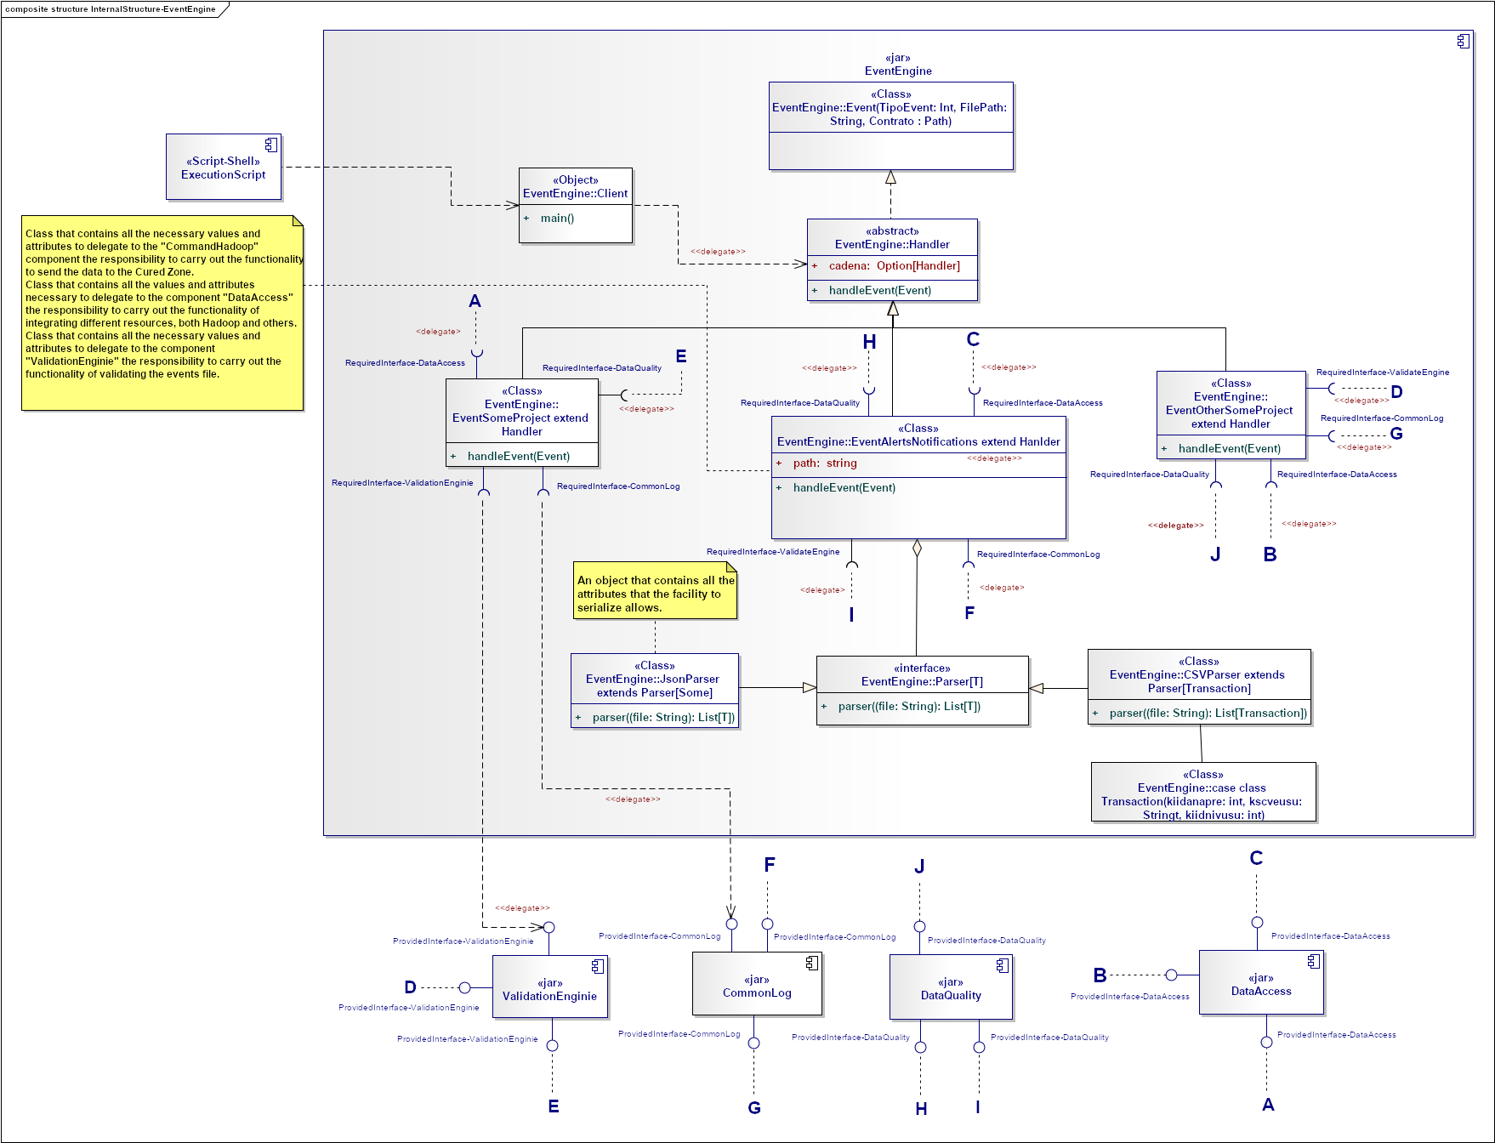
Needs and Solution Proposal (IV)
Data Lake - Alerts and Notifications - Component View II - EventEngine Internal structure
The component is designed to scale according to the needs of the projects, it allows to decouple the functionality of orchestrating the flow of a given project, the call of other components is contemplated that allows to delegate specific functionalities.

Slide 12
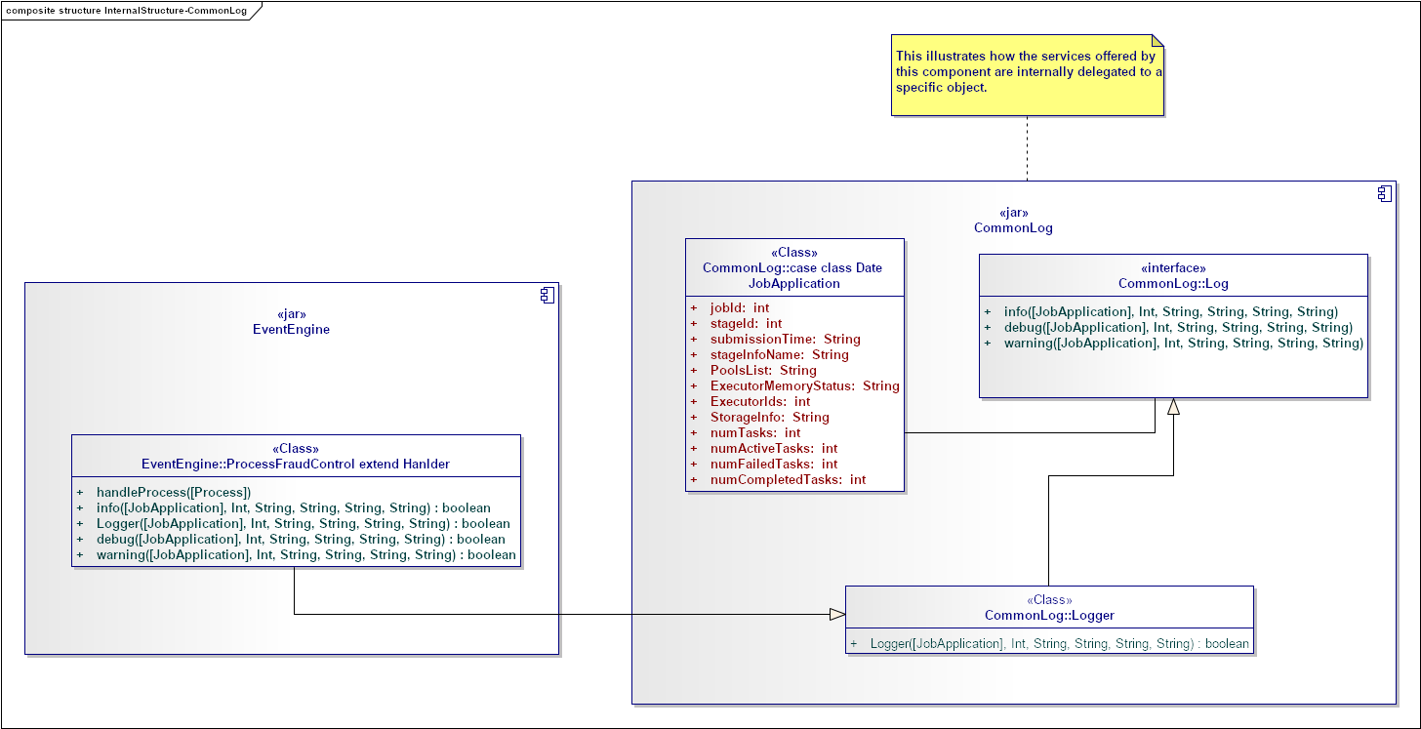
Needs and Solution Proposal (V)
Data Lake - Alerts and Notifications - Component View III - CommonLog Internal structure
The component is designed to scale according to the needs of the projects, it allows decoupling the functionality to record the entire flow of a project. One of its main advantages is that it can be called by different clients, at different points of a certain flow.

Slide 13
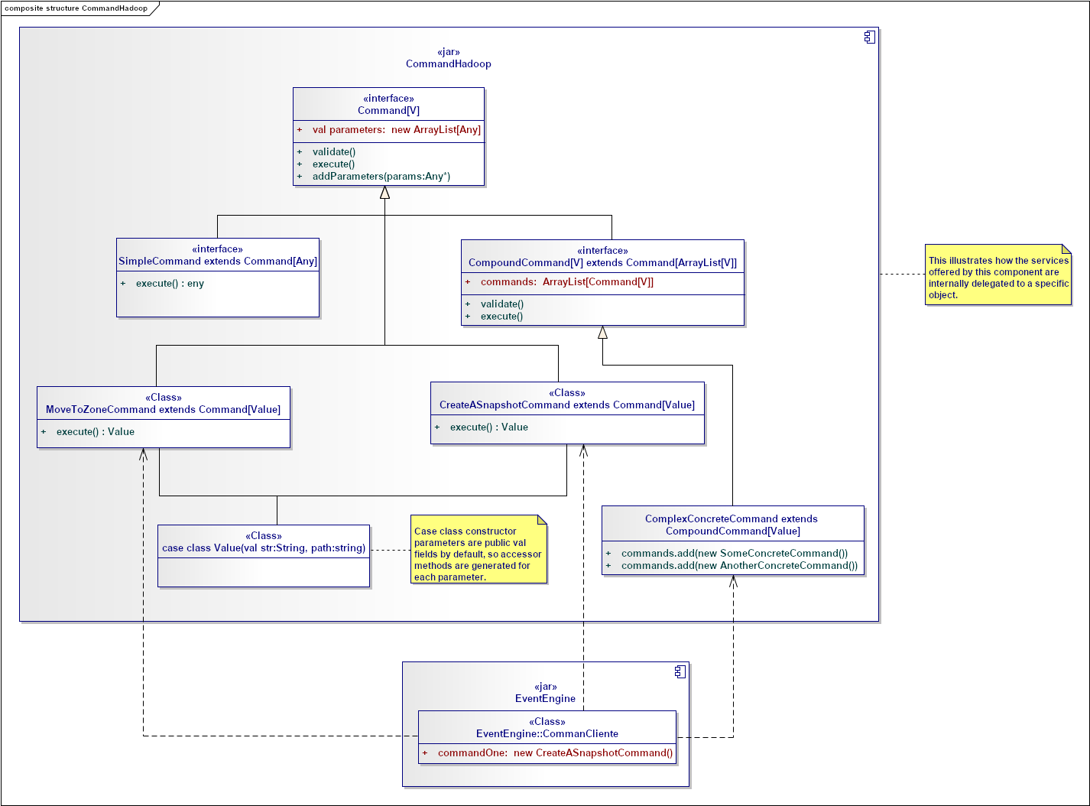
Needs and Solution Proposal (VI)
Data Lake - Alerts and Notifications - Component View IV - CommandHadoop Internal structure
The component is designed to scale according to the needs of the projects, it allows decoupling the functionality to execute Hadoop commands, such as moving to different areas, creating snapshots, deleting files in HDFS, etc. One of its main advantage is that it can be called by different clients, at different points in a flow than different clients.

Slide 14
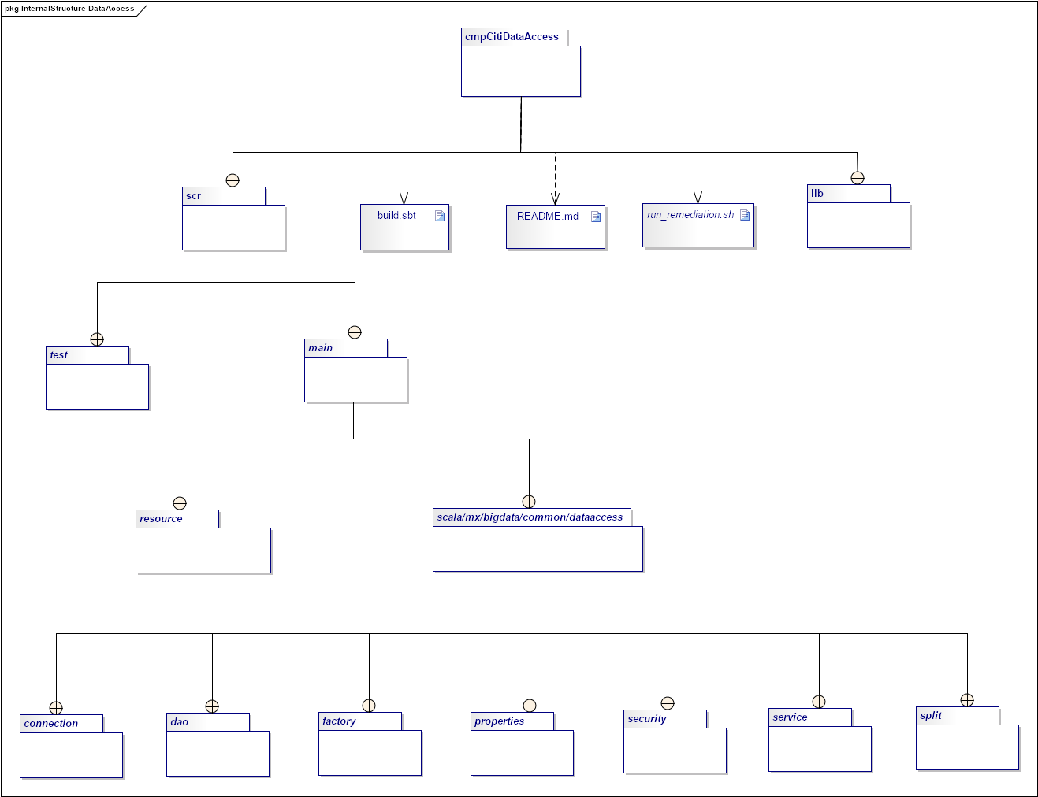
Needs and Solution Proposal (VII)
Data Lake - Alerts and Notifications - Component View V – cmpCitiDataAccess Internal structure
The following diagram reflects the package organization of the cmpCitiDataAccess component.

Slide 15
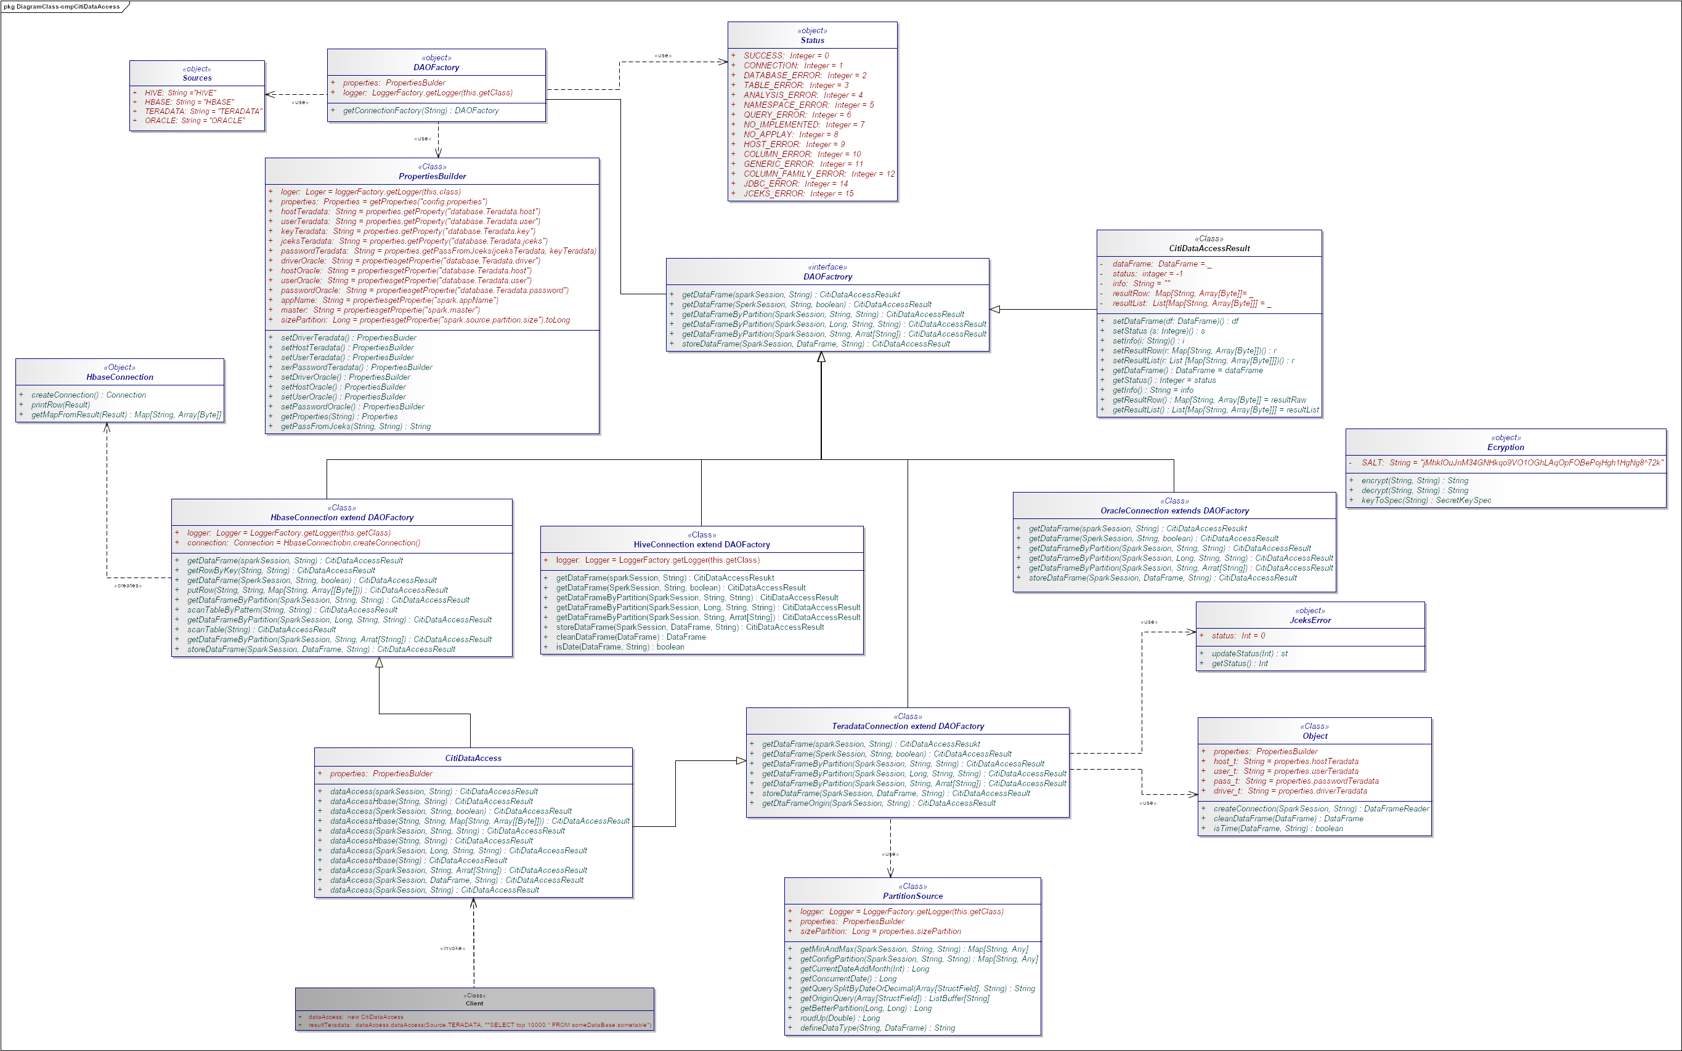
Needs and Solution Proposal (VII)
Data Lake - Alerts and Notifications - Component View VI – Data Access Internal structure
The component is designed to scale according to the needs of the projects, it allows decoupling the functionality of access to different resources (Hive, Hbase, Teradata and Oracle currently). To expose this functionality for Oracle, it is only necessary to include methods in the CitiDataAccess class that encapsulates the functionalities to make it the point of connection with the clients.

Slide 16
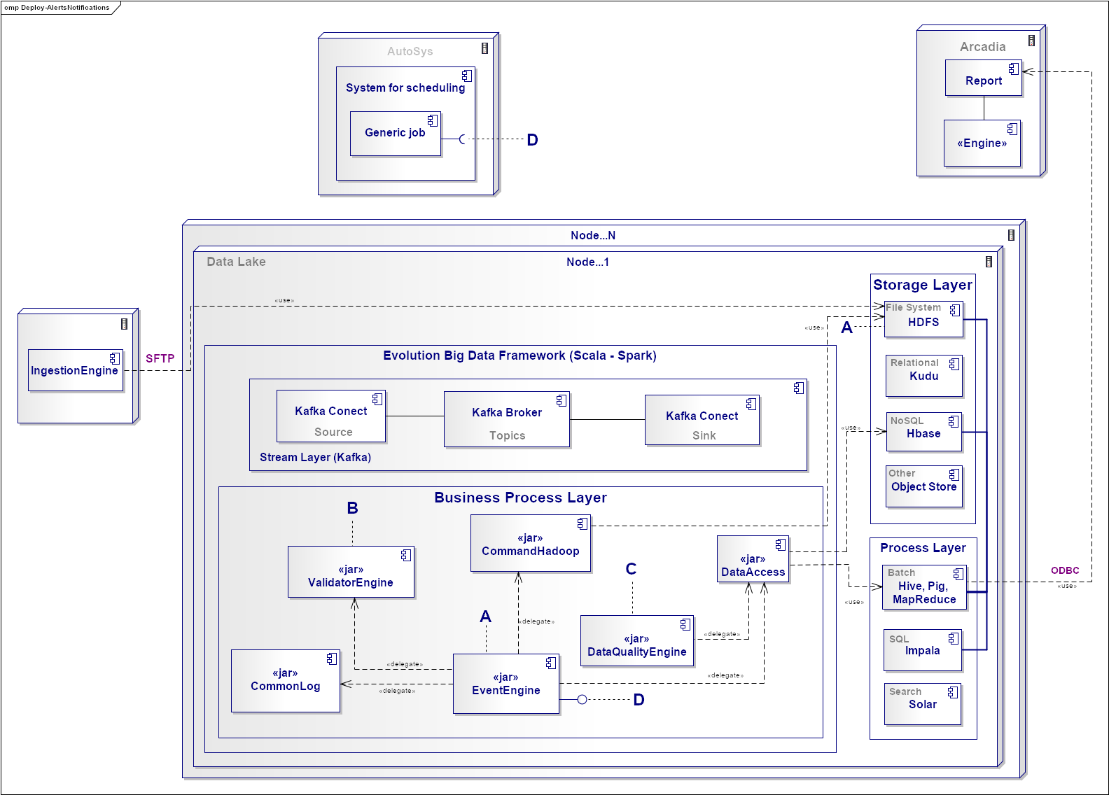
Needs and Solution Proposal (VIII)
Data Lake - Alerts and Notifications – Deployment view

Slide 17
Volumetría (I)
Case of use - Daily Area Events and Notifications
Characteristic | KB / Segundos | KB / Minutos | KB/Horas | MB Díarios | GB X Día | GB X Mes | GB X Año | Nota
According to the volumetry provided by the Alerts and Notifications area, approximately 200 transactions will be made per second. The weight of a single event is approximately 4K | 48000 | 2880000 | 23040000 | 22500 | 21.97265625 | 659.1796875 | 7910.15625 | This projection is made in a uniform way, without considering peaks in transactions, such as days where the largest number of purchases are made.

Slide 18
Servicios Generales (I)
Seguridad
El detalle de los lineamientos mencionados están definidos en los documentos:
Standards for the creation of topics, development and security
Confidencialidad
Communication through mutual authentication and Kerberos between Data Lake (recommendable)
Auditoria:
The CommonLog component is intended to perform auditing functionality for the Fraud Control project process

Slide 19
Risks and Dependencies (I)
Coexistence
The detail of the mentioned guidelines are defined
Validate the integration standards with Data Lake, with Data Governance
Risks
The detail of the mentioned guidelines are defined in the documents:
The method of safety in the ingestion of the intake engine used in the project is unknown.
The ingest engine does not contemplate the use of format for hadoop files, nor a compression format. therefore, the processing of the file with a volume of 21 GB, increases the processing time and therefore consumes more time with Data Lake resources.

Slide 20
Risks and Dependencies (II)
Dependencias
The detail of the mentioned guidelines are defined in the documents :
Standard of Security Controls in Data Lake
If the ingest engine process does not run for some reason or runs in a failed state, the Data Lake job will not run or will run in a failed state.

Slide 21
Standards, Patterns and Decisions of Architecture (I)
Exceptions to Standards and Architecture Patterns
It is a tactical solution that is coupled to the Alerts and Notifications project
The ingest engine towards the Data Lake does not make use of formats for Hadoop (recommended parquet), nor does it make use of compression formats (recommended snappy). This impacts the performance of the Data Lake process. Therefore, the use of these basic principles is recommended in order to care for the resources of the Data Lake cluster.
Architecture Big Data recommends the use of Kafka's connectors (sink), or consumer (piece of code) to send to Hbase, in order to take advantage of Kafka's and Hbase's K: V. At this point a PoC is recommended in non-functional Hbase tests.

Slide 22
Standards, Patterns and Decisions of Architecture (II)
Architecture Decisions
Decisión | Premisas | Razonamiento de la Decisión
Tactical solution | Choose to use a Hive table with Alerts and Notifications Events | Since it is a tactical solution due to the decision to use a simple solution, leaving Hbase aside and only using Hive, it detects a coupling in the handling of Events, and an increase in latency due to the use of Hive. It is a tactical solution that is coupled to the Alerts and Notifications project since in a single Hive table all the events of this project are left, since the separation in different tables by domain in hive would impact the latency, due to the use of different files, crossing data to perform Hive totalization operations, impacts latency and throughput of the process.
MVP | The definition of architecture and the design of the components was given at development time. | Since there were setbacks in the project to be able to define an architecture and it was limited to a simple solution, and the engineering team was not available to cover the entire software engineering process, the delivery of MVP1 is contemplated, which does not coincide 100 percent with the solution, some components were not developed and functionalities were coupled. It is recommended that in the MVP2, different functionalities are decoupled and some dimensions of Data Quality (the most critical for Data Governance) are addressed.
Data completeness | Only the JSON structure defined by contract is covered | As it is a hasty development and definition of architecture and component design, not all the dimensions of the data quality were considered, it was only agreed that the defined structure of the json would be validated under contract with the Alerts and Notifications area. However, it is recommended to establish the necessary actions to guarantee that the required dimensions have been covered. A vulnerability of PII data is detected in all areas, so this point should be addressed, reaching agreements between the different areas to cover this dimension.

Slide 23
Standards, Patterns and Decisions of Architecture (III)
Outbuildings
Dependencia | Componente externo a la solución que impacta | Fecha estimada en la que se requiere disponible
Not apply | Not apply | Not apply

Slide 24
References and Annex (I)
References
Nombre y version | Fecha | Comentarios | Rol/Departamento
Not apply | Not apply | Not apply | Not apply

